Slide 1
Crimson Clubs
Requirements

Slide 2
Description Review
As presented earlier, Crimson Clubs will help clubs and intramurals at Universities keep track of their statistics and schedules
It will be more efficient than competition
It will be user friendly
It will look clean and organized
There will be no advertisments

Slide 3
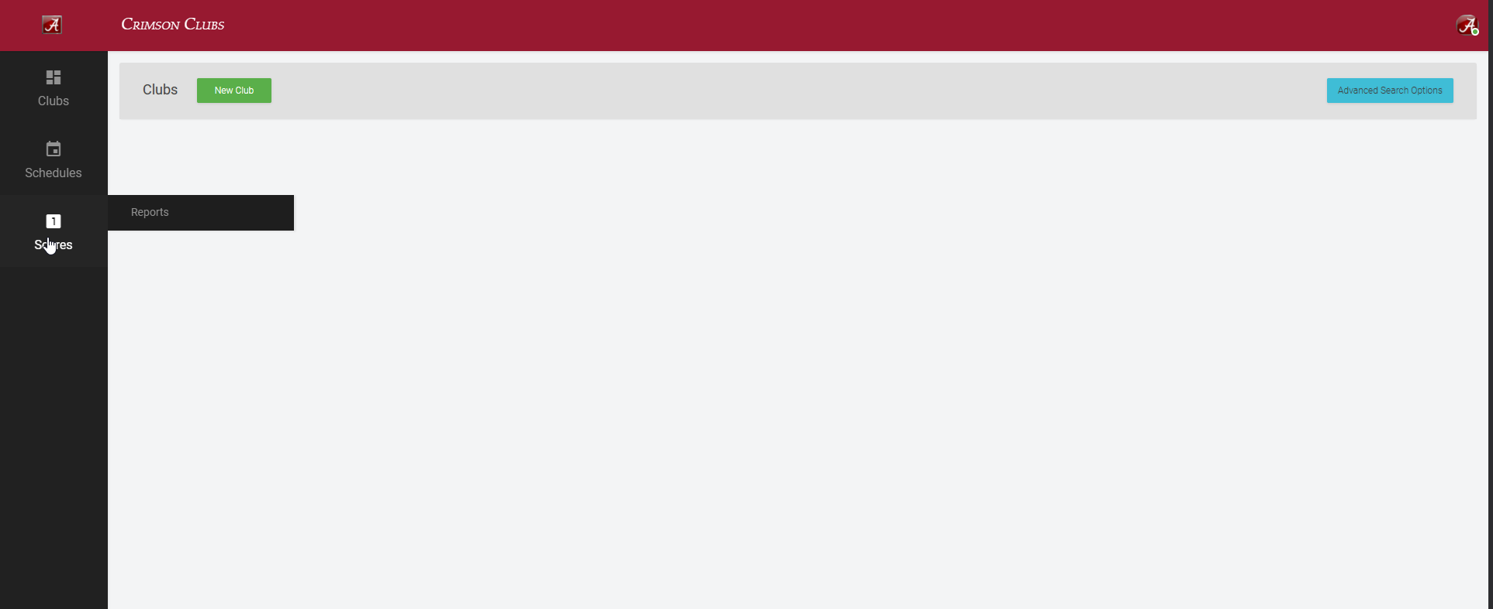
Website (in-progress)

Slide 4
Definitions
Admin vs. Normal

Slide 5
Functional Requirements (Admin)
Add other people/Approve people
Create Events
Push Notifications
Remove People
Modify Description/Info/Tags
Add Stats (Low)

Slide 6
Functional Requirements (Normal)
Request to Join Club/Join Club
Search Clubs
Look at Personal Calendar
Leave Clubs
Look at info
Create Profile
View Event Stats/Leagues (Low)

Slide 7
Non-Functional Requirements

Slide 8
System Architecture

Slide 9
Class Diagram

Slide 10
Use Case Diagrams

Slide 11
Activity Diagrams

Slide 12
Screenshots (Maybe)

Slide 13
System Evolution

Slide 14
Questions

